Slide 1


Monitoring Modern Applications with Datadog in Microsoft Azure

Slide 2




Prashant Nayak, Sr. Cloud Solution Architect at Microsoft
Peter Laudati, Principal Cloud Solution Architect at Microsoft
Matt Burcke, Sr. Cloud Solution Architect at Microsoft
Ryan MacLean, Sr. Advocate at Datadog

Slide 3

What Is What The Hack ?
“What the Hack” is a challenge-based hackathon format
Challenges describe high-level tasks and goals to be accomplished
Challenges are not step-by-step labs.
By having to “figure it out”, attendee knowledge retention is greater
Attendees work in squads of 3 to 5 people to solve the challenges
Attendees “learn from” and “share with” each other.
Coaches provide technical guidance, but not answers to the squads
Coaches may provide lectures & demos to setup challenges & review solutions
What the Hack can be hosted in-person or virtually via Microsoft Teams
Notes:
Quick overview of the format….
Share this if you’re doing a Train The Trainer, or else keep hidden

Slide 4
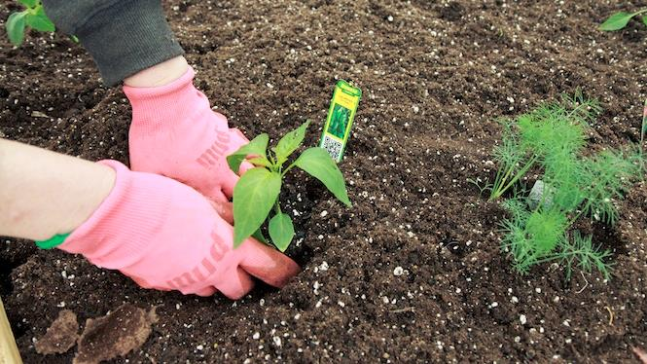
You will get your hands dirty
Notes:
This is a “hands-on” exercise where you will work in groups of 4-5 people to solve technical challenges.
You only get out what you put in, don't be lazy.
Knowledge Retention is achieved through Pain and Discomfort

Slide 5
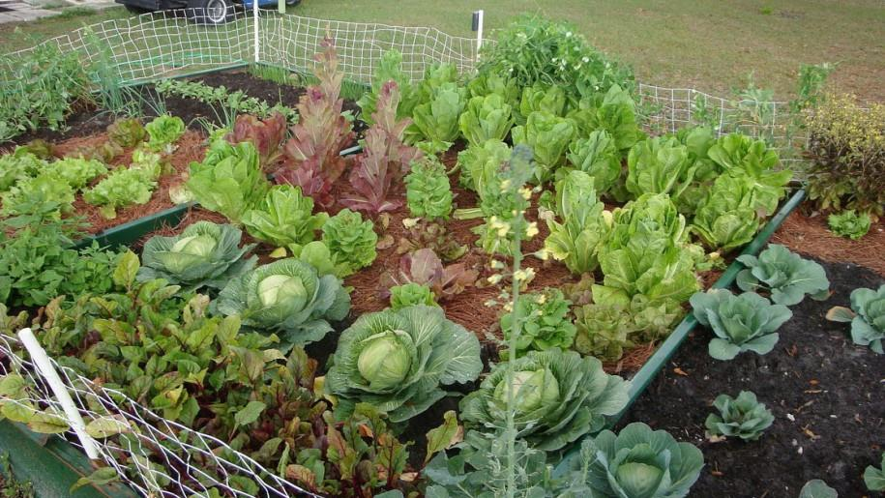
*results may vary
Notes:
You might not grow a garden like this… but at least you can learn while trying.

Slide 6
Challenge Format
Challenges are cumulative, building upon each other.
Establish Confidence – start small and simple (think hello world)
Build Competence – by having successively more complex challenges
Challenges are NOT step-by-step hands-on labs!
No “clicking here” or “copy n pasting there”
Challenge definitions are short. A couple of sentences or bullet points stating the end goal(s) and perhaps a hint at the skill(s) needed.
You MUST work together as a team to figure out how to complete them!

Slide 7
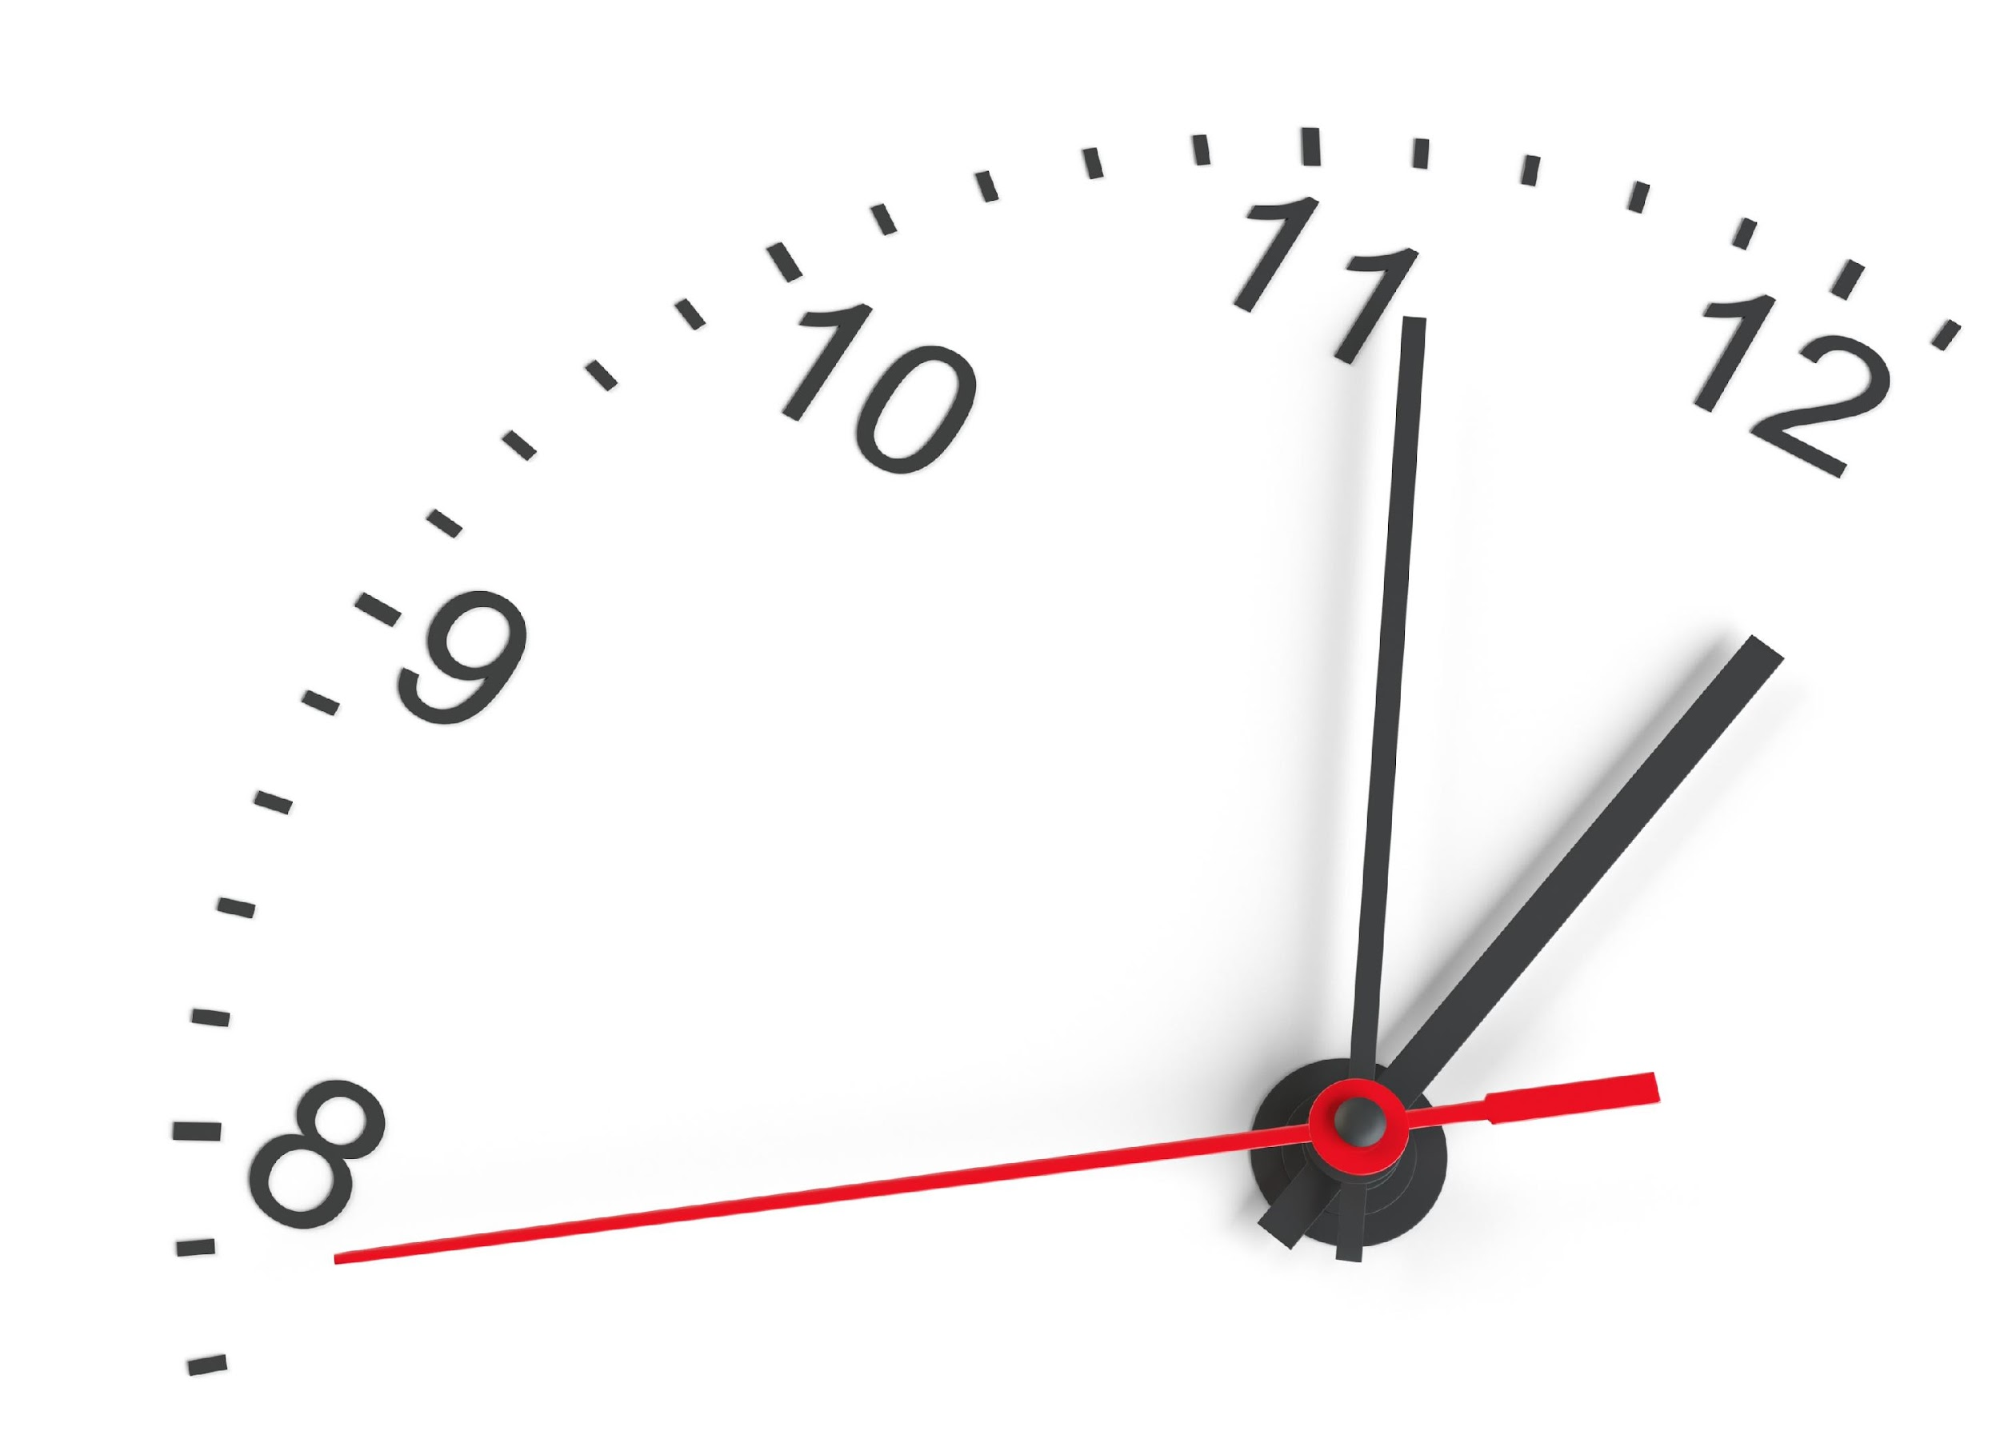
Challenge Format
For each challenge we will deliver a ”mini-lecture” explaining concepts in it.
Coaches will review results for each challenge when all squad members have completed the challenge
Don’t be beholden by the clock!
Move quickly or take it slow.
But stay together with your squad!
Your coach is there to help.
There WILL be more challenges than you can complete in our allotted time!
These are takeaways for follow up at home

Slide 8

Coaches
Each team will have a coach through-out the whole hack.
Use them! But don’t expect them to give you all the answers.
Get to know your coach, their likes and dislikes...
All the better to find a bribe that works!
Notes:
Keep the teams working as teams!
Encourage all to “learn from” and “share with” each other!
If you observe individuals racing ahead, encourage them to help those who are behind.
Encourage attendees to use their team’s channel on MS Teams to collaborate/share info!
Unblock teams who get stuck
Encourage team members to unblock each other first!
Provide hints, but not answers
If you observe individuals stuck for a while, help them get moving so they don’t lose interest.
Provide hints/pointers to the teams on how to solve problems & where to find information.
Use the answers/solutions in the proctor’s guide, but don’t share with the attendees
Proctor’s guide won’t be comprehensive. As SMEs, proctors should use their knowledge to help with solution hints/ideas.
Notify the emcee of unexpected blockers that arise during the event so they can be communicated to all, and recorded for future reference.

Slide 9

Tooling
You can use any tooling you want, but we strongly encourage (and will only support the following):
Azure Cloud Shell
Visual Studio Code
Windows Subsystem for Linux with the Azure CLI installed.

Slide 10

Finding Answers
Search engines are your friend! Azure is a hot technology and much ink has been spilled on it.
The Azure and Datadog docs are your best bet.
Many of the related open source projects used here have top notch documentation!

Slide 11
Challenge 0

Slide 12
Challenge 0 Ready, Set, GO!
Getting started in the workshop environment
Use Azure CloudShell
Deploy Datadog
Success Criteria
Unpack the zip file in CS for the remaining challenges
Use Azure Marketplace
Verify the website and resources are deployed in your subscription
Deploy Datadog to monitor your Azure environment

Slide 13
Datadog Azure Marketplace Offering
Notes:
We are excited to announce a new partnership with Microsoft Azure, which has enabled us to build streamlined experiences for purchasing, configuring, and managing Datadog directly inside the Azure portal.

Slide 14
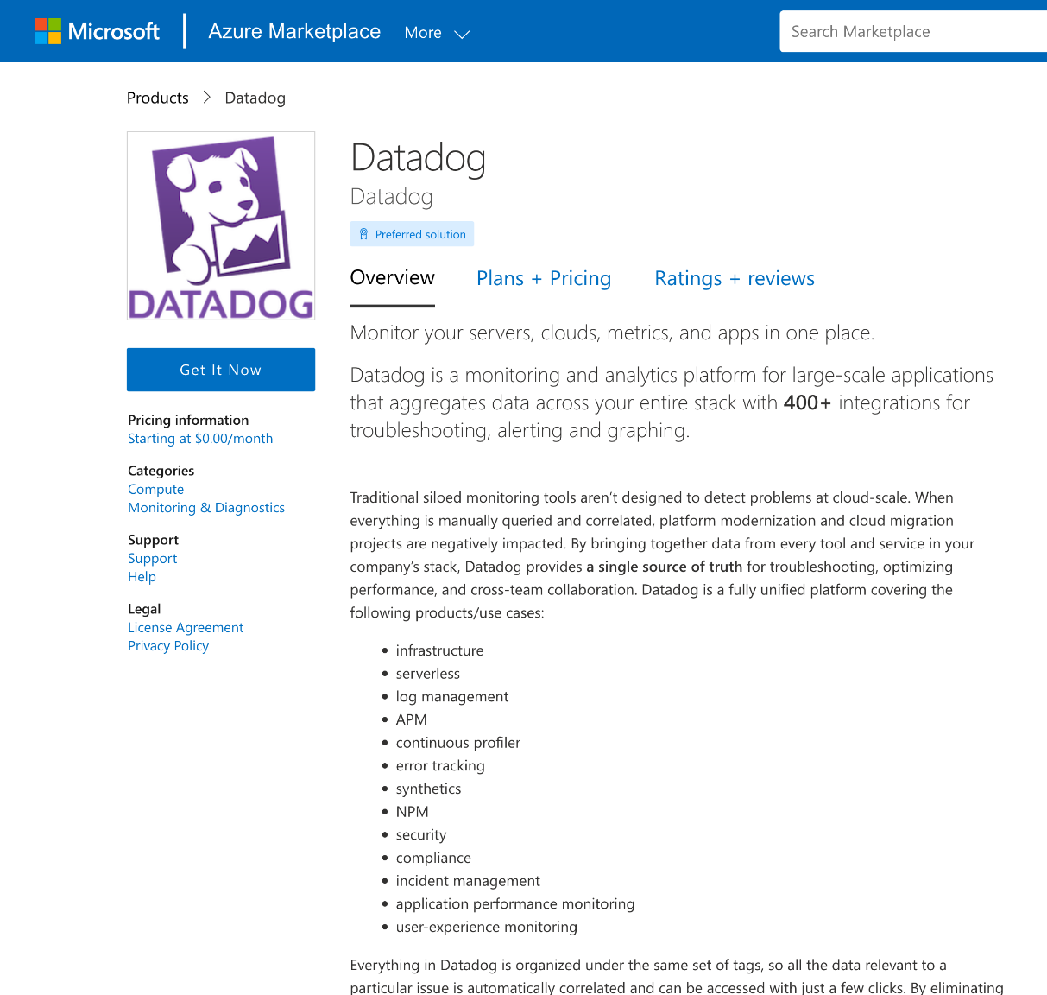
Getting Started with Datadog in Azure
Provisioning through Azure Marketplace
You will perform this in your student environment with Challenge 0
Notes:
The collaboration between Datadog and Azure makes it easier than ever to leverage Datadog’s powerful observability, compliance, and security capabilities for a successful cloud journey in Azure. The new Azure integration is available for all Datadog organizations on our US3 site, whether you created your account through the Azure marketplace or directly with us.

Slide 15
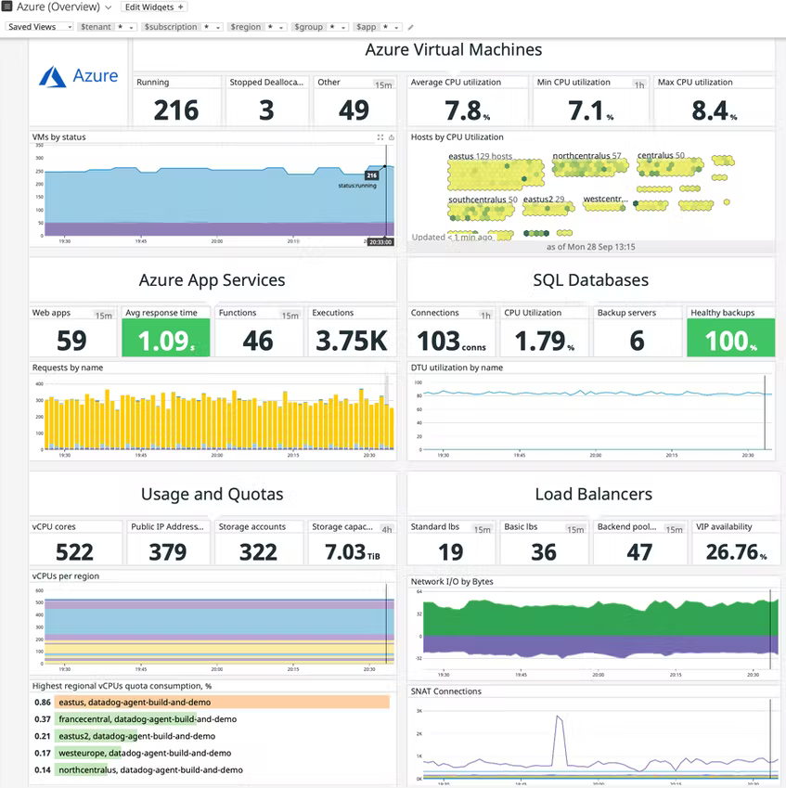
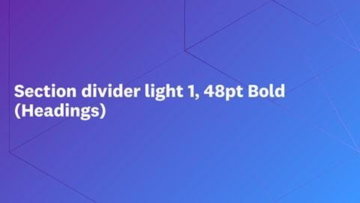




Metrics in Minutes
Go from shopping for a Datadog plan in the Azure Marketplace to visualizing real-time Azure metrics in your Datadog account in minutes.
Bright dividers
Notes:
Go from shopping for a Datadog plan in the Azure Marketplace to visualizing real-time Azure metrics in your Datadog account in minutes.
Once you’ve purchased a Datadog plan through the Azure Marketplace, you’ll immediately start receiving standard Azure Monitor metrics (plus a number of unique Datadog-generated Azure metrics) in your new Datadog account.

Slide 16
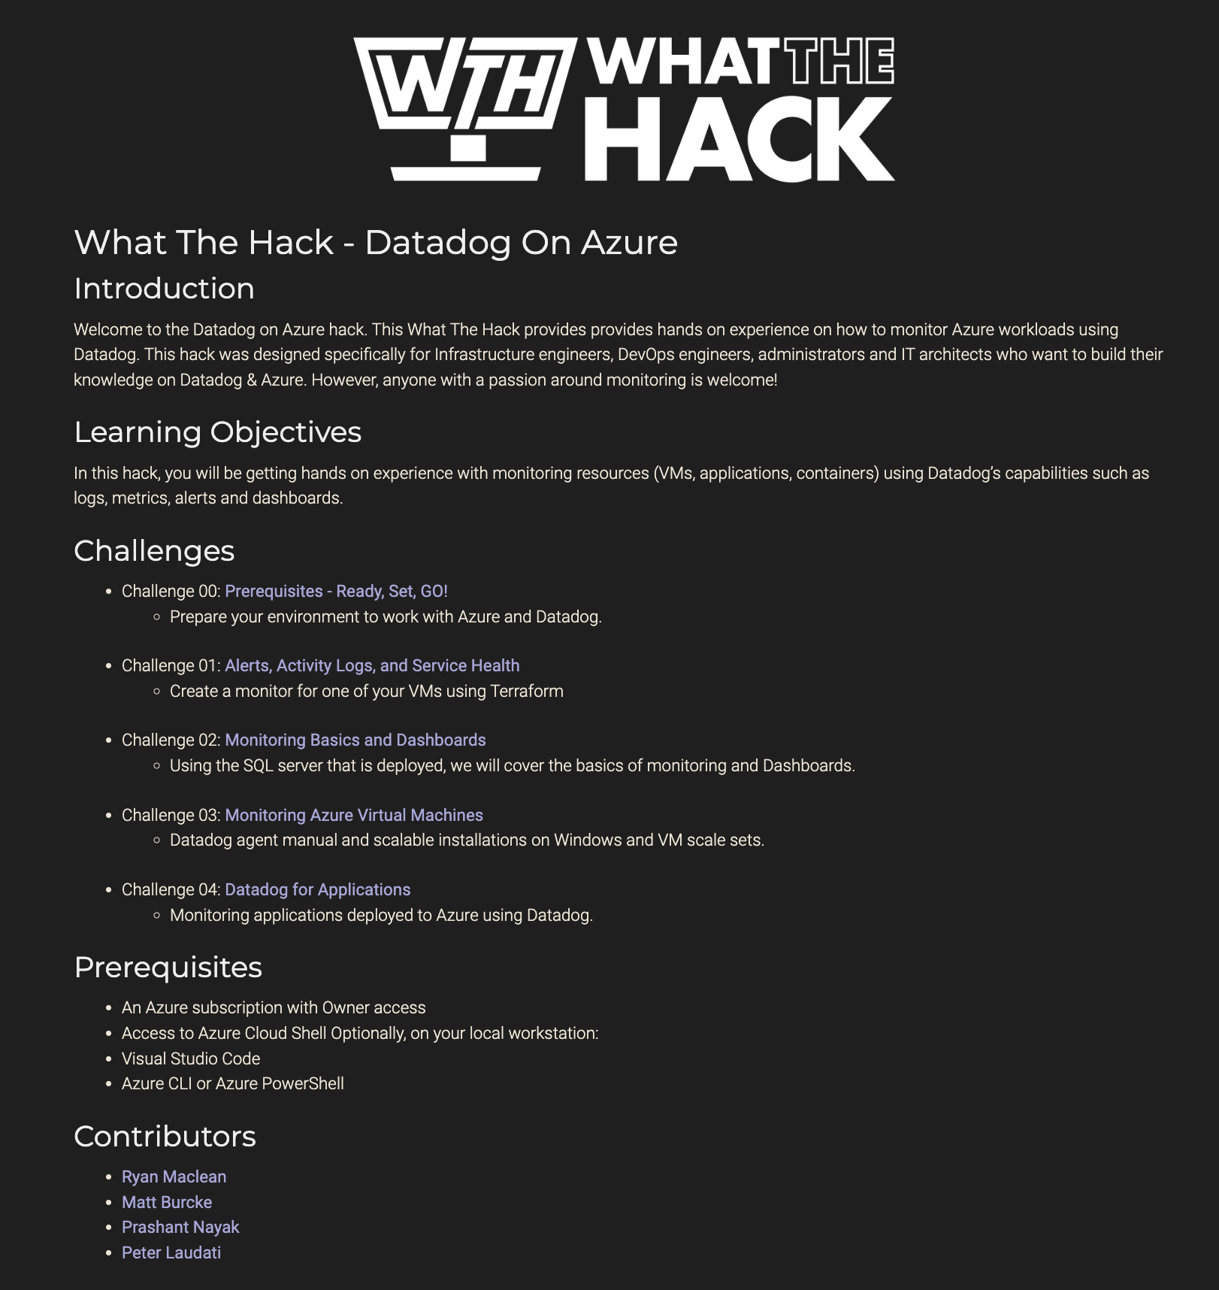
Getting Started with the Workshop
1.) Navigate to student guide: https://aka.ms/AzureDash2022
Lab Duration is 8 hours
Perform workshop in an InPrivate window
Notes:
The collaboration between Datadog and Azure makes it easier than ever to leverage Datadog’s powerful observability, compliance, and security capabilities for a successful cloud journey in Azure. The new Azure integration is available for all Datadog organizations on our US3 site, whether you created your account through the Azure marketplace or directly with us.

Slide 17
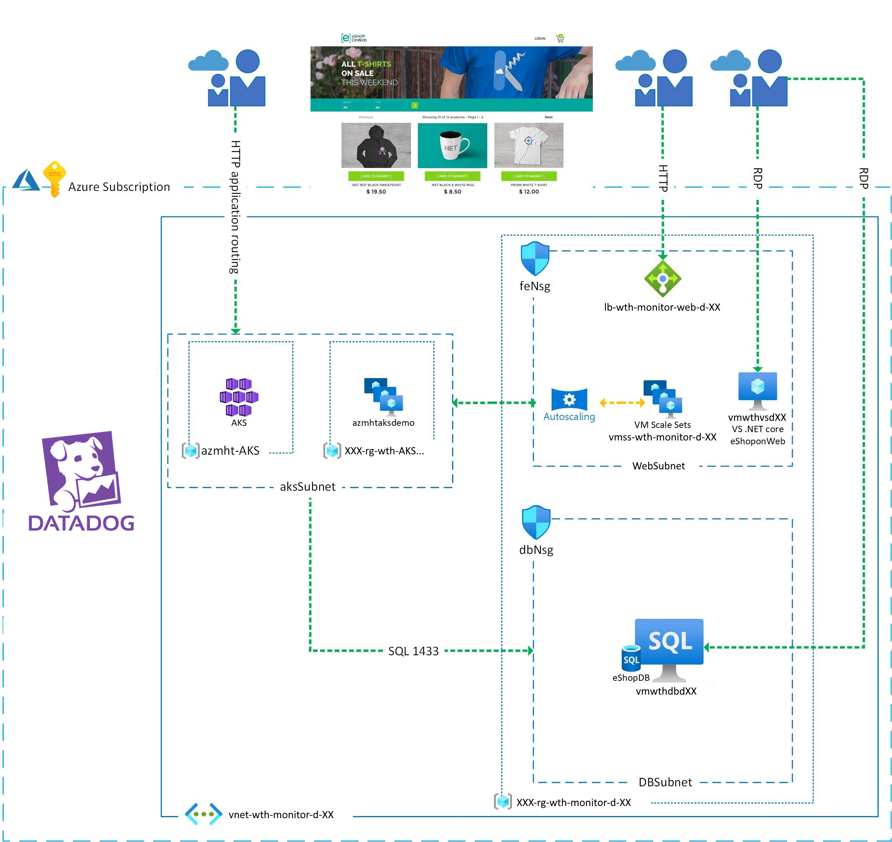

Slide 18
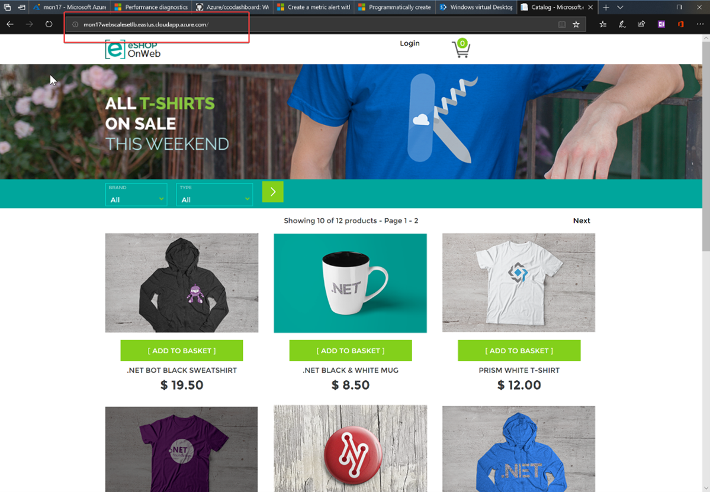

Slide 19
Challenge 1
https://aka.ms/AzureDash2022
https://aka.ms/AzureDash2022Lab
Code: ACTIVATE26499

Slide 20
Challenge 1 Alerts, Activity Logs, and Service Health
You will deploy Datadog monitors via Terraform to monitor performance of your Azure VM.
Use Azure CloudShell
Stuck on Terraform?
Success Criteria
All the resources including the script and Terraform are included in Azure CS
If you haven’t used Terraform before, or need clarification, ask for help.
Ensure you have two new monitors deployed in the Datadog portal

Slide 21
Challenge 2
https://aka.ms/AzureDash2022
https://aka.ms/AzureDash2022Lab
Code: ACTIVATE26499

Slide 22
Challenge 2 Monitoring Basics and Dashboards
Display the results on a dashboard for visualization and alerting purposes. Once you have configured the counters to be collected, you will use two tools to simulate a load on the eShopOnWeb resources.
Deploy SQL Monitoring
Monitoring
Success Criteria
You will need to monitor the SQL server via Datadog in the lab environment to successfully complete this challenge
We will be leveraging Datadog dashboards, monitors, and alerts to accomplish this challenge.
Verify that the Datadog is collecting the metrics.
Show the Datadog dashboard with the database metric in it, which should show a spike representing before and after the database stress test. Show the Datadog dashboard with the CPU metric in it, which should show a spoke representing before and after the CPU load test.

Slide 23
Challenge 3

Slide 24
Challenge 3 Monitoring Azure Virtual Machines
You will put together a comprehensive solution to monitor virtual machine operations.
Azure VM Scale Set
Monitoring and Policy
Success Criteria
Install the agent through the automation built-into Azure VMSS.
Create a new dashboard that will contain the required graphs
Use Azure Policy to enable Configuration Management resources to monitor VM operations and performance.
Show your dashboard with VM metrics, logs, process monitoring, Azure Automation and networking with a drop-down selector for hosts.

Slide 25
Challenge 4

Slide 26
Challenge 4 Datadog for Applications
You will deploy configure Datadog Dotnet APM to allow for continuous performance and usability monitoring.
Datadog Agent for APM
RUM (Real User Monitoring)
Success Criteria
Install and configure the Datadog Agent to receive traces from your instrumented application
Inject RUM snippet into your code
Create a Monitor to get triggered when the exception happen.
Show the errors in Datadog and the Alert fired
Show that the client browser data is showing up in RUM

Slide 27
Thank You!
See our other What The Hacks at: https://aka.ms/wth
Take other Datadog courses at your own pace at: learn.datadoghq.com
Notes:
Read or paraphrase this:
“We created this workshop for Dash and we want to make it even better. We take feedback very seriously and our Training team lead reads every response personally. Please take 3 minutes to share your thoughts right now while it’s fresh on your mind.”

